Slide 1

Automatic Target Recognition in SAR Images Using Deep Learning
by
ADITYA SHARMA 2018A7PS0367P
AAYUSH ATUL VERMA 2017A7PS0061P

Slide 2
Acknowledgements
We would like to thank Dr J. Jennifer Ranjani for giving us the opportunity to work in this intriguing field. Her constant guidance and vast experience helped us throughout this project.
We would also like to use this opportunity to thank the Computer Science Department of BITS Pilani for granting us great opportunities and the platform of project-oriented courses to work on topics beyond the curriculum.

Slide 3
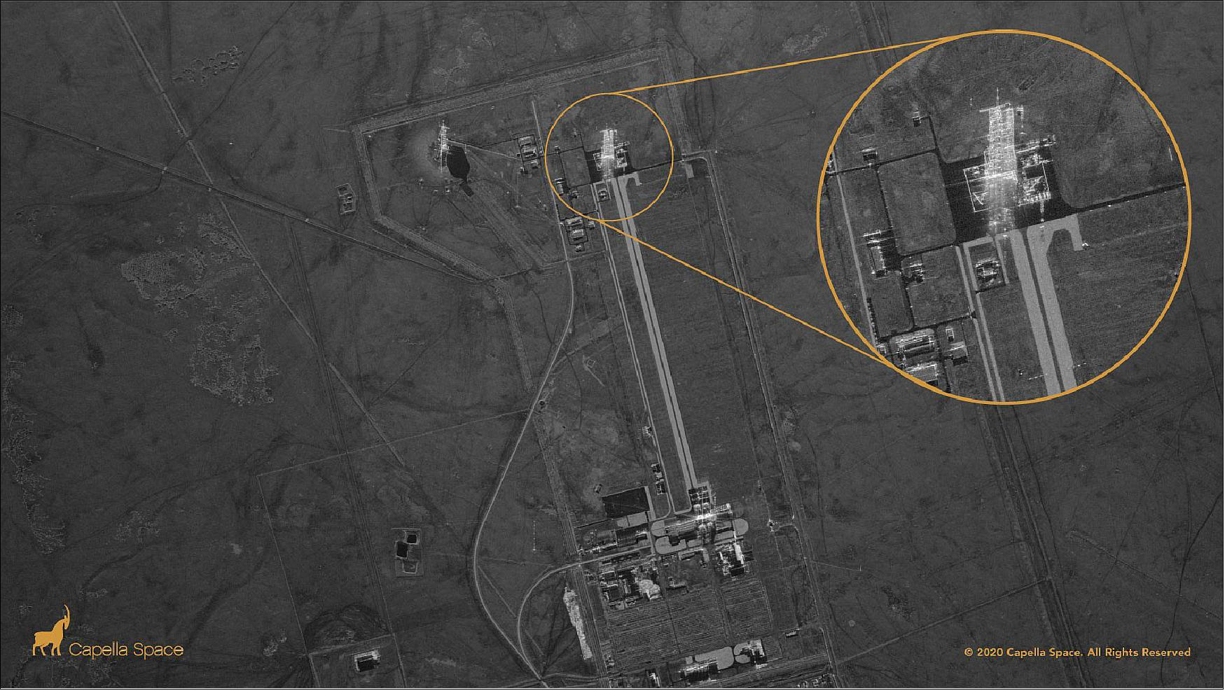
Introduction
Synthetic Aperture Radar (SAR) is an active ground observation system which can return high quality images at all times of the day irrespective of the weather conditions.
They are installed on aircrafts, satellites, spacecraft and flight platforms.
Its has applications in day to day monitoring
and for military purposes.
Regions with high pixel density denote the
possibility of a target.
SAR Automatic Target Recognition aims to
extract the location and type of the target
SAR images lack of optical colour range, making
ATR prone to overfitting
SAR image taken from a satellite

Slide 4


Background Study
Synthetic Aperture Radar ATR framework
Preprocessing images using MATLAB
Traditional Image classification techniques
Object Detection Techniques
RetinaNet
YOLO
Faster RCNN
Traditional Image classification vs Deep Learning pipeline

Slide 5
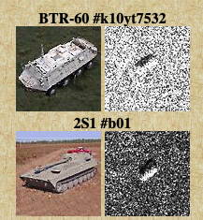
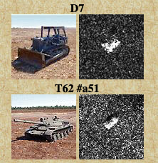
Dataset
The images in the dataset are from the publicly released MSTAR dataset that includes categories of tanks based on the ground target. There were two types of SAR images present for each class - images with a 17º depression angle and images with a 15º depression angle. All images with a 17º depression angle are used in training while the remaining images are used for testing purposes and are not included in the training process.
Images of the original image beside their SAR image

Slide 6
Class | 2S1 | D7 | ZIL131 | BTR60 | BTR70 | ZSU_23_4 | T62 | T72 | BMP2 | BRDM_2
Train | 300 | 300 | 300 | 257 | 234 | 300 | 299 | 233 | 234 | 257
Test | 275 | 275 | 275 | 196 | 197 | 275 | 274 | 197 | 196 | 275
Number of images in the respective train and test sets
The dataset is slightly imbalanced with a varying degree of noise present in each class.
The image dimensions and size also varies from class to class.

Slide 7
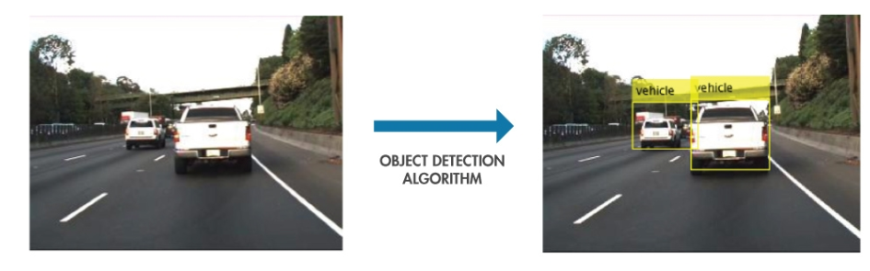
Object Detection

Slide 8
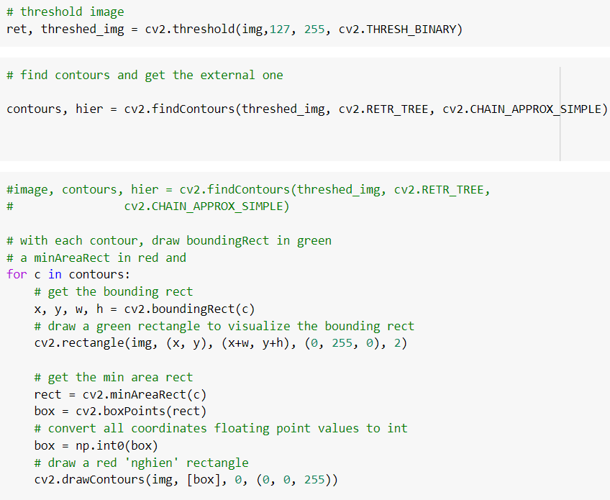
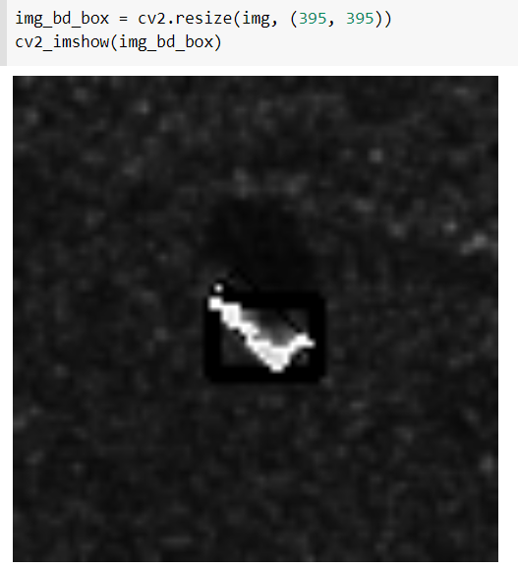
Bounding boxes using OpenCV
Object localisation was done via an OpenCV library using the cv2.boundingRect() and cv2.minAreaRect() functions.
Deliverable 1
Some issues were observed in a few images. The bounding boxes were not completely getting encompassed in some images.
Deliverable 2
Deliverable 4
Implementation
Result

Slide 9
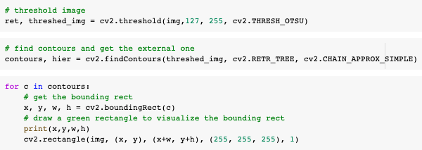
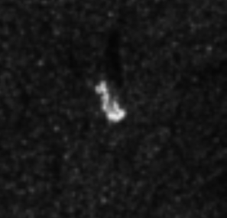
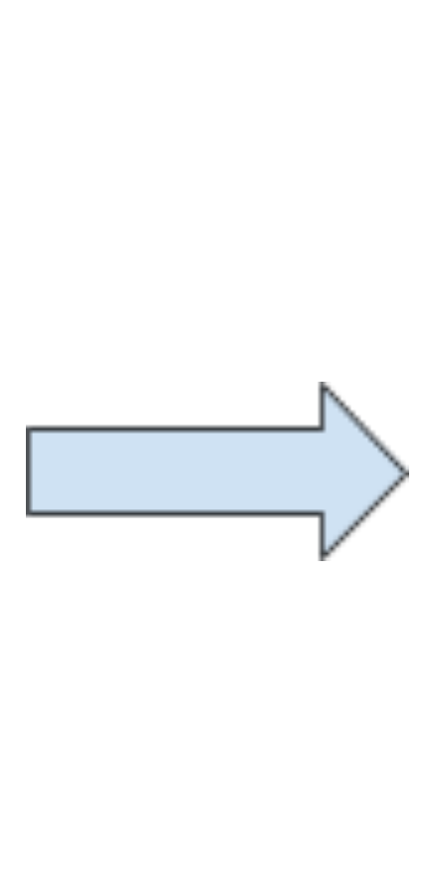
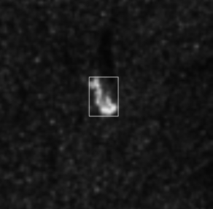
Bounding boxes using OTSU for threshold
To have a better contrast in the recognition between the target and its background, we applied OTSU thresholding to each image.
Deliverable 1
Deliverable 2
Implementation
Results

Slide 10
Models for Object Detection

Slide 11
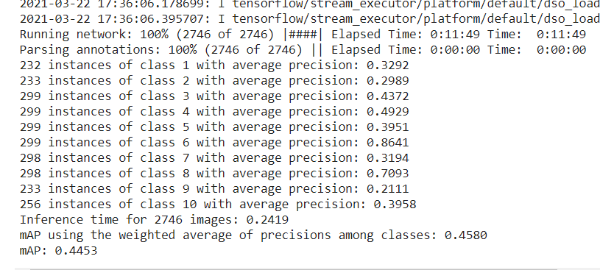
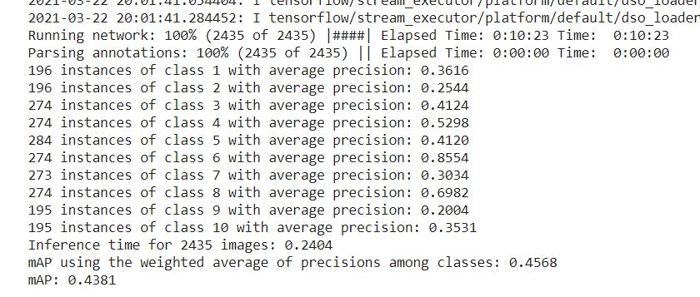
Using RetinaNet
Retinanet gave very low accuracy. One of the possible reasons for this can be setting the batch size very low(4). Upon increasing the batch size, the model was not getting trained due to memory and GPU limitations.
Training the model
Prediction on testing data

Slide 12
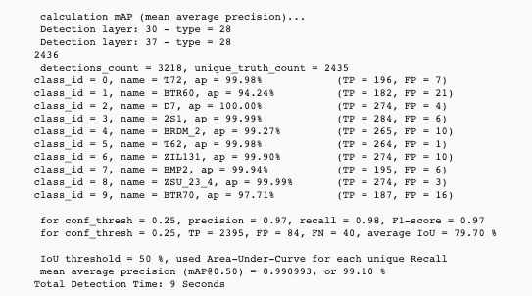
YOLOv4 on Original Dataset
Observations
Higher mean average precision(mAP) as compared to RetinaNet.
Testing takes approximately 20 seconds on average.
A few classes underperforming with respect to the average of the dataset - namely BTR60 and BTR70.
Next Steps
Performing data augmentation and manually curating the dataset using the LabelImg tool
Class wise mean average precision on training using YOLOv4

Slide 13
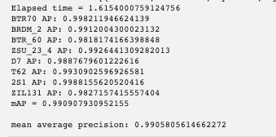
Faster RCNN
Faster RCNN trained for 50 epochs
Observations
Average Precision has increased to 0.9905
Performance of BTR60 and BTR70 has significantly increased.
Time to detect one image is approximately 1.6 seconds and a total of approximately an hour to iterate through the entire test set.
Speed tradeoff vs the YOLOv4 model to achieve a better accuracy is huge
Class wise mean average precision on training using YOLOv4

Slide 14
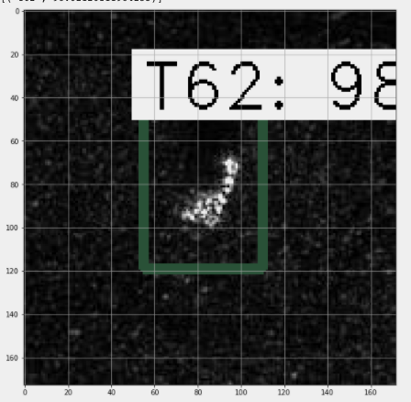
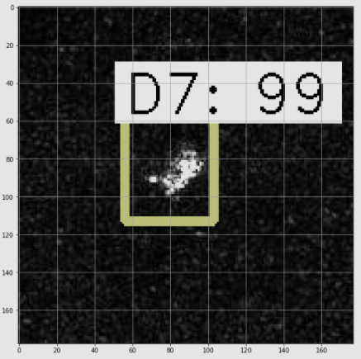
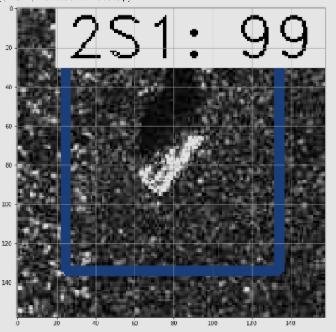
Output of Faster RCNN
Sample predictions made by the Faster RCNN model

Slide 15
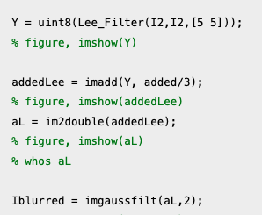
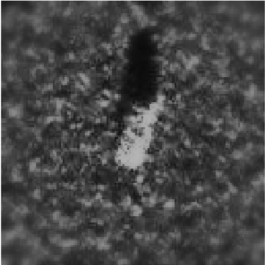
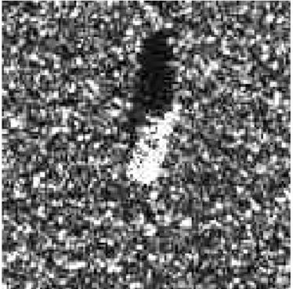
Preprocessing
As we observed that due to a large amount of noise in some images, the YOLO model did not converge as well as FasterRCNN. The FasterRCNN model faced some issues too as can be observed in the generalisation of the RPN for regression.
To tackle the noise, we performed the following preprocessing steps on MATLAB.
Change in the brightness and contrast of the images
Used the lee filter
Weighted superimposition of the above two changes to form a new image
Gaussian Filter
Code snippet for preprocessing
Preprocessing of an image

Slide 16
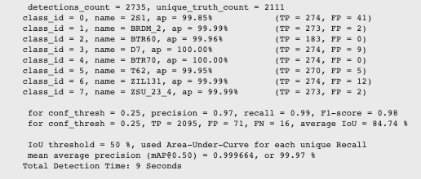
YOLOv4 on Preprocessed data
To work on the speed attained by FasterRCNN we tried to implement the YOLO algorithm on the new dataset.
Observations
The average precision of classes BTR60 and BTR70 is much higher than before and is comparable to other classes too. The entire testing time took around 20 seconds on average as compared to an hour for FasterRCNN.
The accuracy achieved by YOLO is comparable to FasterRCNN too.
Class wise mean average precision on training using YOLOv4

Slide 17
Conclusion
Faster RCNN gave better results in terms of average precision in comparison to YOLO on the original dataset. However, YOLO gave much faster predictions on the Test set.
Faster RCNN took almost an hour to calculate the complete mean average precision(mAP) value on the test image dataset of 2400 images, whereas YOLO took just 20 seconds for the same task. Hence initially there was a tradeoff between accuracy(measured in mAP) and time(measured in seconds) on shifting between the two models.
However, after applying the respective preprocessing techniques mentioned above in the report, and then using YOLO on the preprocessed dataset, we were able to increase the accuracy of YOLO to the extent of Faster RCNN along with the fast speed of YOLO(20 seconds).
Thus there can be improvements achieved in ATR for SAR images by performing specific preprocessing techniques to clean the images.

Slide 18
Future Scope
Object detection in the domain of SAR images is not explored much. Hence there is a lot of scope for improvements. This project can be further extended to include these preprocessing techniques in the original architecture of YOLO itself, specifically designed for SAR target recognition with better accuracy along with the fast speed of YOLO. This project was specifically directed towards the tank targets of MSTAR dataset.
Various other SAR datasets, such as the ship dataset, can be used to examine the applicability of these techniques further and whether there can be some more preprocessing techniques used.
A more detailed study can be done to see the effects of the preprocessing techniques on the bounding box creation function.

Slide 19
THANK YOU

